Slide 1


Sarah Chitaha
5 Jan 2024

Slide 2

Outline
Executive Summary
Introduction
Methodology
Results
Conclusion
Appendix

Slide 3
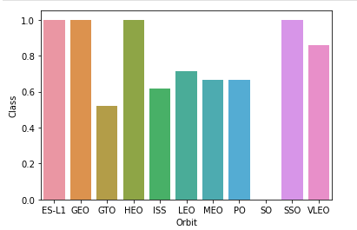
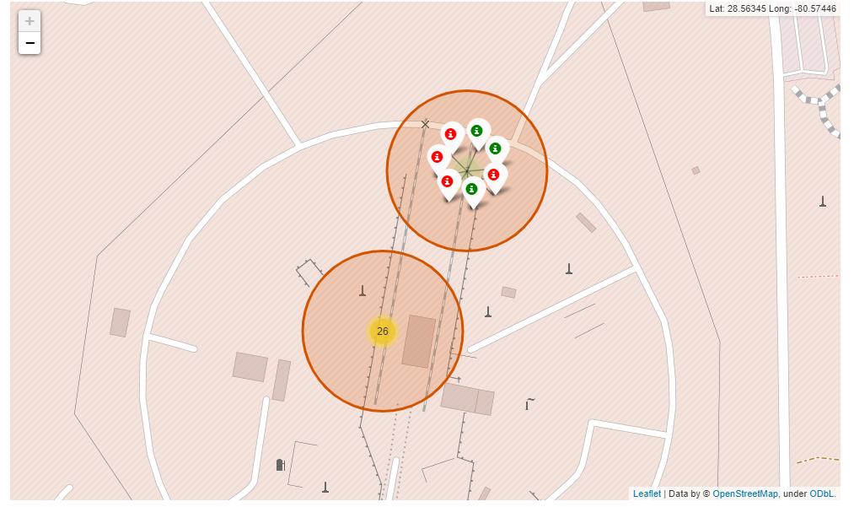
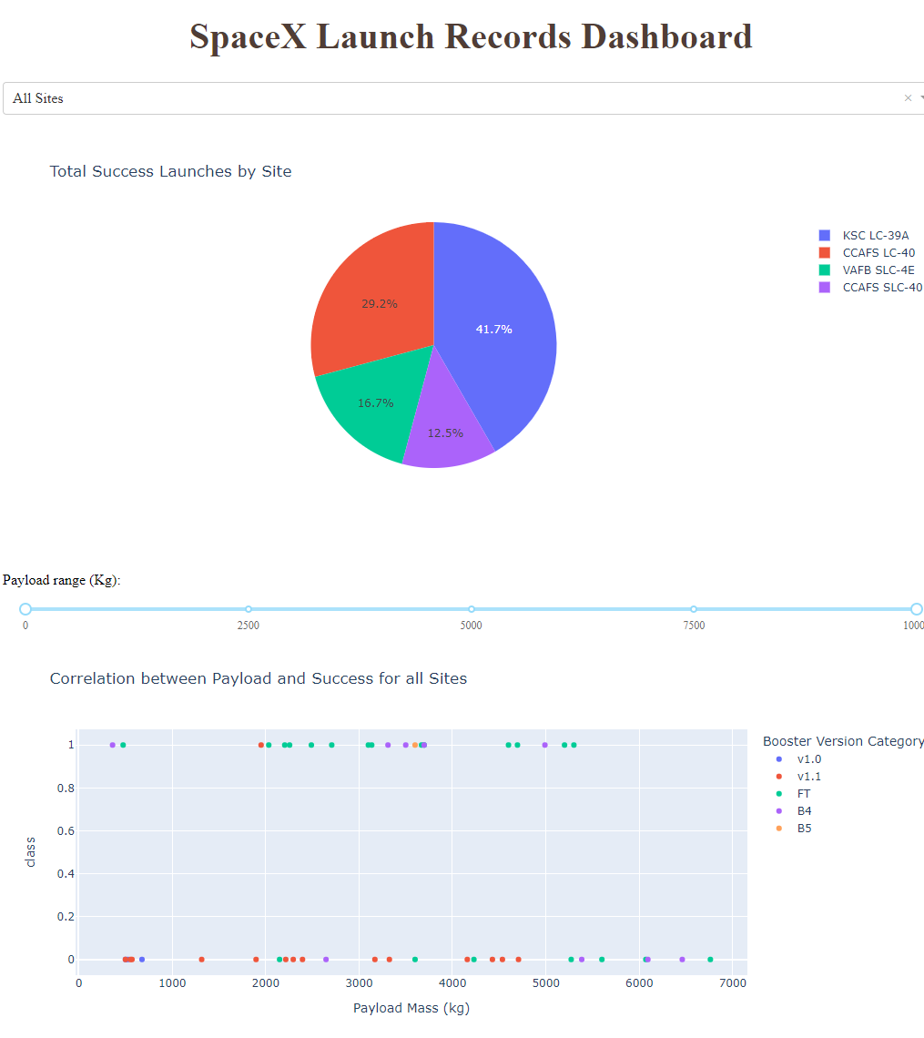
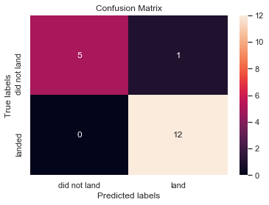
EXECUTIVE SUMMARY
Executive Summary
Summary of Methodologies:
This project follows these steps:
Data Collection
Data Wrangling
Exploratory Data Analysis
Interactive Visual Analytics
Predictive Analysis (Classification)
Summary of Results:
This project produced the following outputs and visualizations:
Exploratory Data Analysis (EDA) results
Geospatial analytics
Interactive dashboard
Predictive analysis of classification models
1
2
3
4

Slide 4

Introduction
SpaceX launches Falcon 9 rockets at a cost of around $62m. This is considerably cheaper than other providers (which usually cost upwards of $165m), and much of the savings are because SpaceX can land and then re-use the rocket's first stage.
If we can predict whether the first stage will land, we can determine the cost of a launch, and use this information to assess whether or not an alternate company should bid and SpaceX for a rocket launch.
This project will ultimately predict whether the first Space X Falcon 9 stage will land successfully.

Slide 5

Section 1

Slide 6
METHODOLOGY SUMMARY
Methodology
Data Collection
Making GET requests to the SpaceX REST API
Web Scraping
Data Wrangling
Using the .fillna() method to remove NaN values
Using the .value_counts() method to determine the following:
Number of launches on each site
Number and occurrence of each orbit
Number and occurrence of mission outcome per orbit type
Creating a landing outcome label that shows the following:
0 when the booster did not land successfully
1 when the booster did land successfully
Exploratory Data Analysis
Using SQL queries to manipulate and evaluate the SpaceX dataset
Using Pandas and Matplotlib to visualize relationships between variables, and determine patterns
Interactive Visual Analytics
Geospatial analytics using Folium
Creating an interactive dashboard using Plotly Dash
Data Modelling and Evaluation
Using Scikit-Learn to:
Pre-process (standardize) the data
Split the data into training and testing data using train_test_split
Train different classification models
Find hyperparameters using GridSearchCV
Plotting confusion matrices for each classification model
Assessing the accuracy of each classification model

Slide 7
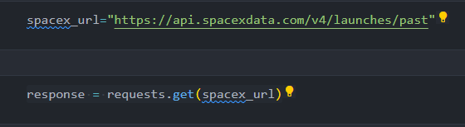
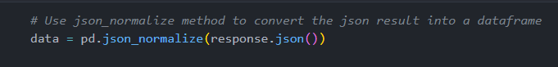
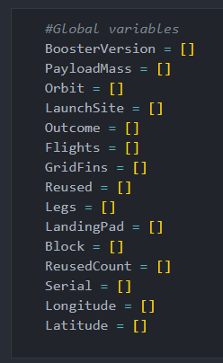
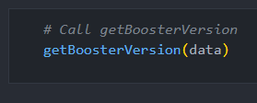
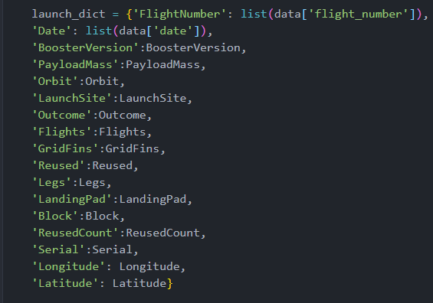
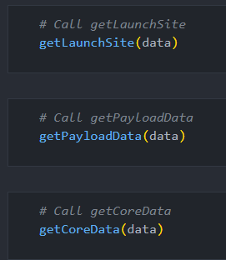
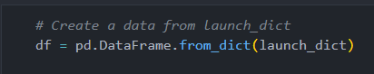
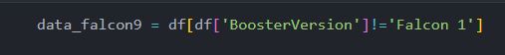


DATA COLLECTION – space x REST api
GitHub Link
Data Collection – SpaceX API
1
Using the SpaceX API to retrieve data about launches, including information about the rocket used, payload delivered, launch specifications, landing specifications, and landing outcome.
2
1
Make a GET response to the SpaceX REST API
Convert the response to a .json file then to a Pandas DataFrame
2
Use custom logic to clean the data (see Appendix)
Define lists for data to be stored in
Call custom functions (see Appendix) to retrieve data and fill the lists
Use these lists as values in a dictionary and construct the dataset
3
3
Create a Pandas DataFrame from the constructed dictionary dataset
4
4
Filter the DataFrame to only include Falcon 9 launches
Reset the FlightNumber column
Replace missing values of PayloadMass with the mean PayloadMass value

Slide 8

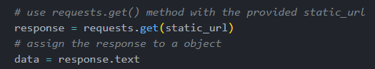


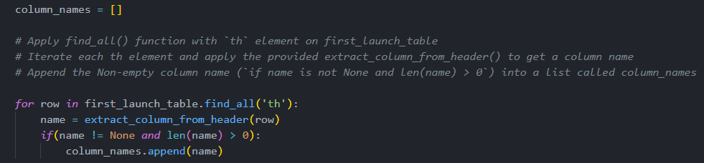
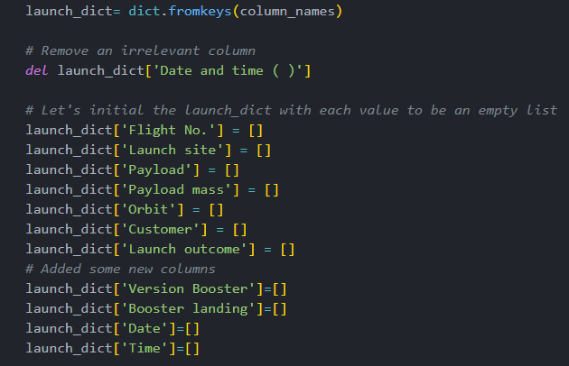
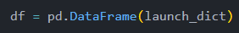
DATA COLLECTION – WEB SCRAPING
GitHub Link
Data Collection - Scraping
1
Web scraping to collect Falcon 9 historical launch records from a Wikipedia page titled List of Falcon 9 and Falcon Heavy launches.
2
1
Request the HTML page from the static URL
Assign the response to an object
3
2
Create a BeautifulSoup object from the HTML response object
Find all tables within the HTML page
3
4
Collect all column header names from the tables found within the HTML page
4
Use the column names as keys in a dictionary
Use custom functions and logic to parse all launch tables (see Appendix) to fill the dictionary values
5
Convert the dictionary to a Pandas DataFrame ready for export
5

Slide 9
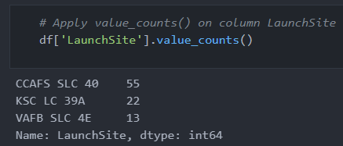
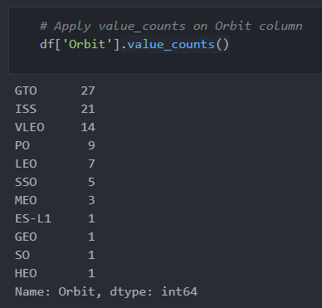
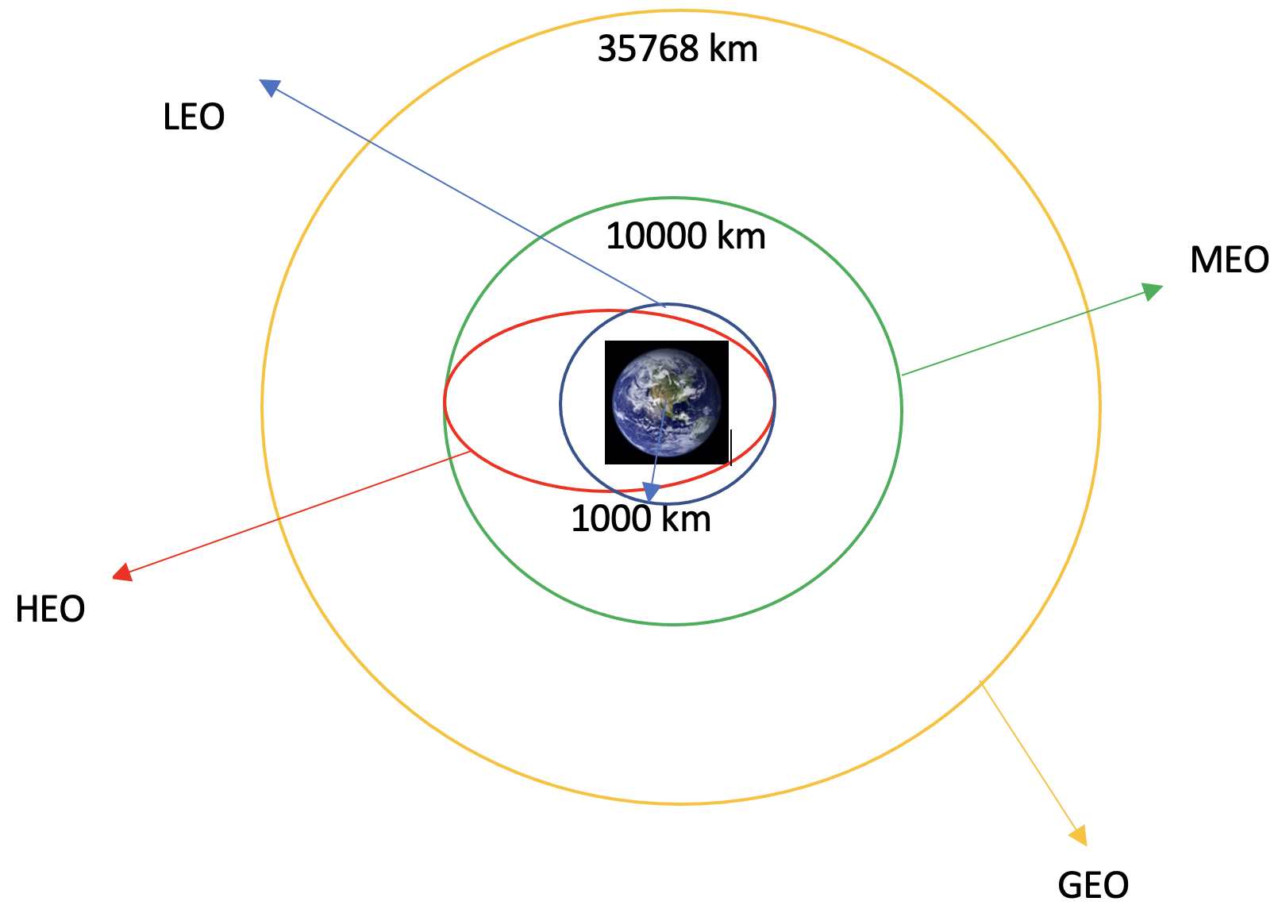
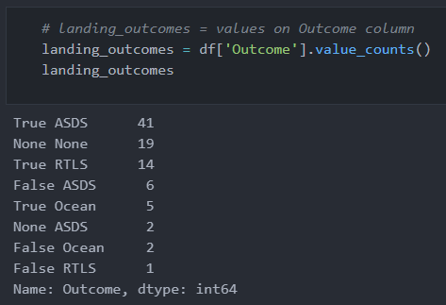
DATA MANIPULATION/WRANGLING – PANDAS
1
Data Wrangling
GitHub Link
Context:
The SpaceX dataset contains several Space X launch facilities, and each location is in the LaunchSite column.
Each launch aims to a dedicated orbit, and some of the common orbit types are shown in the figure below. The orbit type is in the Orbit column.
Initial Data Exploration:
Using the .value_counts() method to determine the following:
Number of launches on each site
Number and occurrence of each orbit
Number and occurrence of landing outcome per orbit type
2
3

Slide 10
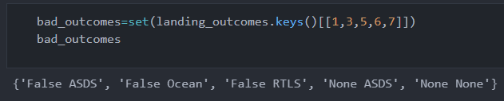
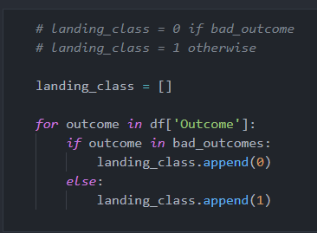

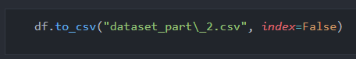
DATA MANIPULATION/WRANGLING – PANDAS
GitHub Link
Data Wrangling
Context:
The landing outcome is shown in the Outcome column:
True Ocean – the mission outcome was successfully landed to a specific region of the ocean
False Ocean – the mission outcome was unsuccessfully landed to a specific region of the ocean.
True RTLS – the mission outcome was successfully landed to a ground pad
False RTLS – the mission outcome was unsuccessfully landed to a ground pad.
True ASDS – the mission outcome was successfully landed to a drone ship
False ASDS – the mission outcome was unsuccessfully landed to a drone ship.
None ASDS and None None – these represent a failure to land.
Data Wrangling:
To determine whether a booster will successfully land, it is best to have a binary column, i.e., where the value is 1 or 0, representing the success of the landing.
This is done by:
Defining a set of unsuccessful (bad) outcomes, bad_outcome
Creating a list, landing_class, where the element is 0 if the corresponding row in Outcome is in the set bad_outcome, otherwise, it’s 1.
Create a Class column that contains the values from the list landing_class
Export the DataFrame as a .csv file.
1
3
3
4

Slide 11
Exploratory data analysis (eda) – visualization
GitHub Link
EDA with Data Visualization
SCATTER CHARTS
BAR CHART
LINE CHARTS
Scatter charts were produced to visualize the relationships between:
Flight Number and Launch Site
Payload and Launch Site
Orbit Type and Flight Number
Payload and Orbit Type
A bar chart was produced to visualize the relationship between:
Success Rate and Orbit Type
Line charts were produced to visualize the relationships between:
Success Rate and Year (i.e. the launch success yearly trend)
Scatter charts are useful to observe relationships, or correlations, between two numeric variables.
Bar charts are used to compare a numerical value to a categorical variable. Horizontal or vertical bar charts can be used, depending on the size of the data.
Line charts contain numerical values on both axes, and are generally used to show the change of a variable over time.

Slide 12
GitHub Link
EDA with SQL
To gather some information about the dataset, some SQL queries were performed.
The SQL queries performed on the data set were used to:
Display the names of the unique launch sites in the space mission
Display 5 records where launch sites begin with the string ‘CCA’
Display the total payload mass carried by boosters launched by NASA (CRS)
Display the average payload mass carried by booster version F9 v1.1
List the date when the first successful landing outcome on a ground pad was achieved
List the names of the boosters which had success on a drone ship and a payload mass between 4000 and 6000 kg
List the total number of successful and failed mission outcomes
List the names of the booster versions which have carried the maximum payload mass
List the failed landing outcomes on drone ships, their booster versions, and launch site names for 2015
Rank the count of landing outcomes (such as Failure (drone ship) or Success (ground pad)) between the date 2010-06-04 and 2017-03-20, in descending order

Slide 13
Geospatial analysis – folium
Build an Interactive Map with Folium
GitHub Link
The following steps were taken to visualize the launch data on an interactive map:
Mark all launch sites on a map
Initialise the map using a Folium Map object
Add a folium.Circle and folium.Marker for each launch site on the launch map
Mark the success/failed launches for each site on a map
As many launches have the same coordinates, it makes sense to cluster them together.
Before clustering them, assign a marker colour of successful (class = 1) as green, and failed (class = 0) as red.
To put the launches into clusters, for each launch, add a folium.Marker to the MarkerCluster() object.
Create an icon as a text label, assigning the icon_color as the marker_colour determined previously.
Calculate the distances between a launch site to its proximities
To explore the proximities of launch sites, calculations of distances between points can be made using the Lat and Long values.
After marking a point using the Lat and Long values, create a folium.Marker object to show the distance.
To display the distance line between two points, draw a folium.PolyLine and add this to the map.

Slide 14
Interactive dashboard – plotly dash
GitHub Link
Build a Dashboard with Plotly Dash
The following plots were added to a Plotly Dash dashboard to have an interactive visualisation of the data:
Pie chart (px.pie()) showing the total successful launches per site
This makes it clear to see which sites are most successful
The chart could also be filtered (using a dcc.Dropdown() object) to see the success/failure ratio for an individual site
Scatter graph (px.scatter()) to show the correlation between outcome (success or not) and payload mass (kg)
This could be filtered (using a RangeSlider() object) by ranges of payload masses
It could also be filtered by booster version

Slide 15
Predictive Analysis - Classification
GitHub Link
Predictive Analysis (Classification)
The following steps were taking to develop, evaluate, and find the best performing classification model:
Model Development
Model Evaluation
Finding the Best Classification Model
1
To prepare the dataset for model development:
Load dataset
Perform necessary data transformations (standardise and pre-process)
Split data into training and test data sets, using train_test_split()
Decide which type of machine learning algorithms are most appropriate
For each chosen algorithm:
Create a GridSearchCV object and a dictionary of parameters
Fit the object to the parameters
Use the training data set to train the model
For each chosen algorithm:
Using the output GridSearchCV object:
Check the tuned hyperparameters (best_params_)
Check the accuracy (score and best_score_)
Plot and examine the Confusion Matrix
Review the accuracy scores for all chosen algorithms
The model with the highest accuracy score is determined as the best performing model

Slide 16
Results
Exploratory data analysis results
Interactive analytics demo in screenshots
Predictive analysis results

Slide 17

Section 2

Slide 18
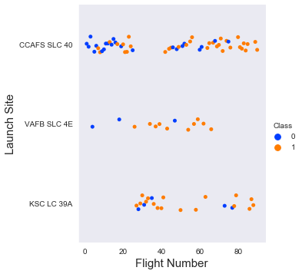
Flight Number vs. Launch Site
The scatter plot of Launch Site vs. Flight Number shows that:
As the number of flights increases, the rate of success at a launch site increases.
Most of the early flights (flight numbers < 30) were launched from CCAFS SLC 40, and were generally unsuccessful.
The flights from VAFB SLC 4E also show this trend, that earlier flights were less successful.
No early flights were launched from KSC LC 39A, so the launches from this site are more successful.
Above a flight number of around 30, there are significantly more successful landings (Class = 1).

Slide 19
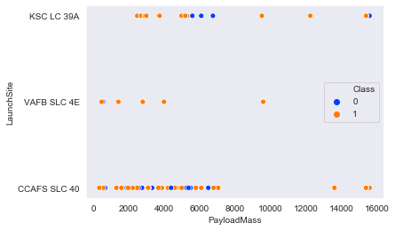
Payload vs. Launch Site
The scatter plot of Launch Site vs. Payload Mass shows that:
Above a payload mass of around 7000 kg, there are very few unsuccessful landings, but there is also far less data for these heavier launches.
There is no clear correlation between payload mass and success rate for a given launch site.
All sites launched a variety of payload masses, with most of the launches from CCAFS SLC 40 being comparatively lighter payloads (with some outliers).

Slide 20
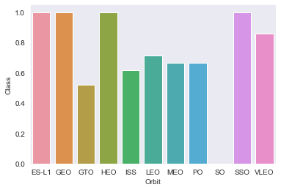
Success Rate vs. Orbit Type
The bar chart of Success Rate vs. Orbit Type shows that the following orbits have the highest (100%) success rate:
ES-L1 (Earth-Sun First Lagrangian Point)
GEO (Geostationary Orbit)
HEO (High Earth Orbit)
SSO (Sun-synchronous Orbit)
The orbit with the lowest (0%) success rate is:
SO (Heliocentric Orbit)

Slide 21
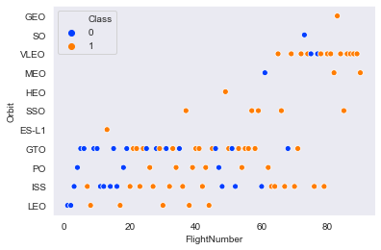
Flight Number vs. Orbit Type
This scatter plot of Orbit Type vs. Flight number shows a few useful things that the previous plots did not, such as:
The 100% success rate of GEO, HEO, and ES-L1 orbits can be explained by only having 1 flight into the respective orbits.
The 100% success rate in SSO is more impressive, with 5 successful flights.
There is little relationship between Flight Number and Success Rate for GTO.
Generally, as Flight Number increases, the success rate increases. This is most extreme for LEO, where unsuccessful landings only occurred for the low flight numbers (early launches).

Slide 22
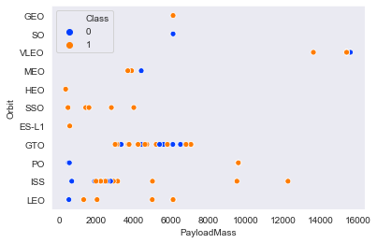
Payload vs. Orbit Type
This scatter plot of Orbit Type vs. Payload Mass shows that:
The following orbit types have more success with heavy payloads:
PO (although the number of data points is small)
ISS
LEO
For GTO, the relationship between payload mass and success rate is unclear.
VLEO (Very Low Earth Orbit) launches are associated with heavier payloads, which makes intuitive sense.

Slide 23
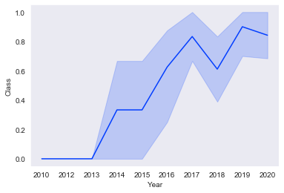
Launch Success Yearly Trend
The line chart of yearly average success rate shows that:
Between 2010 and 2013, all landings were unsuccessful (as the success rate is 0).
After 2013, the success rate generally increased, despite small dips in 2018 and 2020.
After 2016, there was always a greater than 50% chance of success.

Slide 24
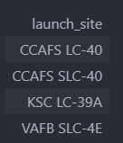
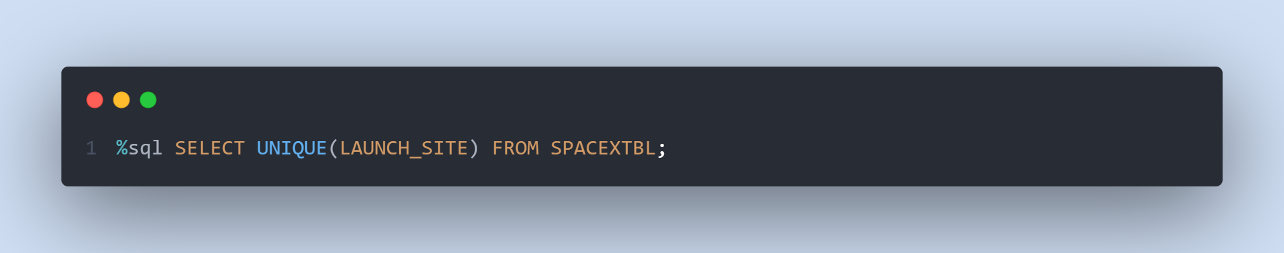
All Launch Site Names
Find the names of the unique launch sites.
The word UNIQUE returns only unique values from the LAUNCH_SITE column of the SPACEXTBL table.

Slide 25
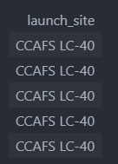
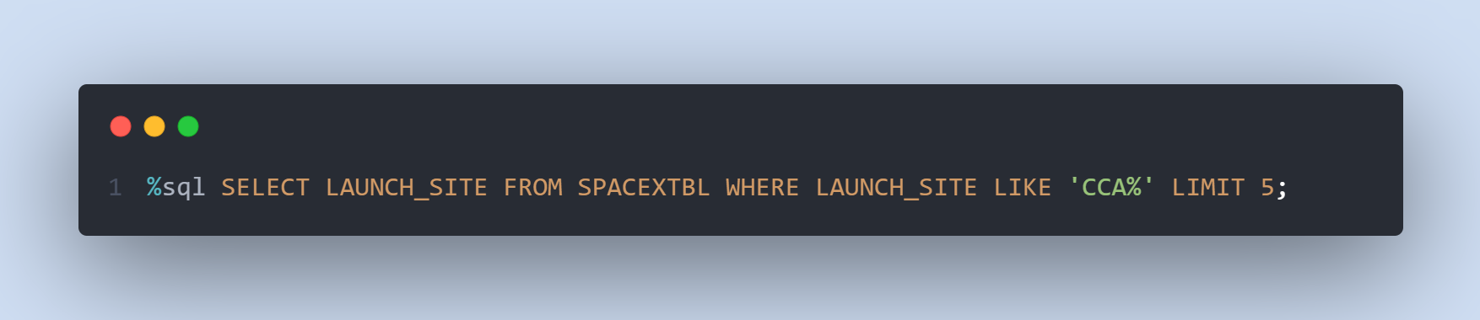
Launch Site Names Begin with 'CCA'
Find 5 records where launch sites begin with ‘CCA’.
LIMIT 5 fetches only 5 records, and the LIKE keyword is used with the wild card ‘CCA%’ to retrieve string values beginning with ‘CCA’.

Slide 26
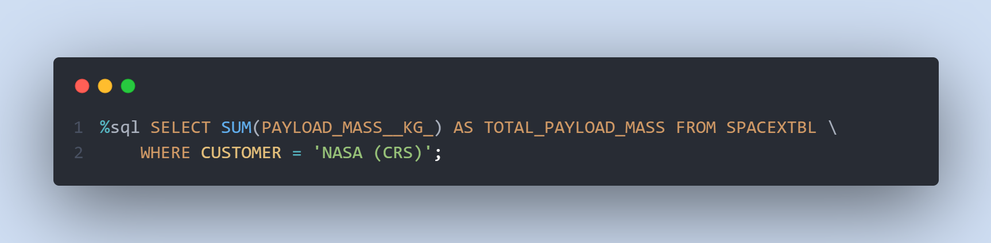
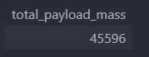
Total Payload Mass
Calculate the total payload carried by boosters from NASA.
The SUM keyword is used to calculate the total of the LAUNCH column, and the SUM keyword (and the associated condition) filters the results to only boosters from NASA (CRS).

Slide 27
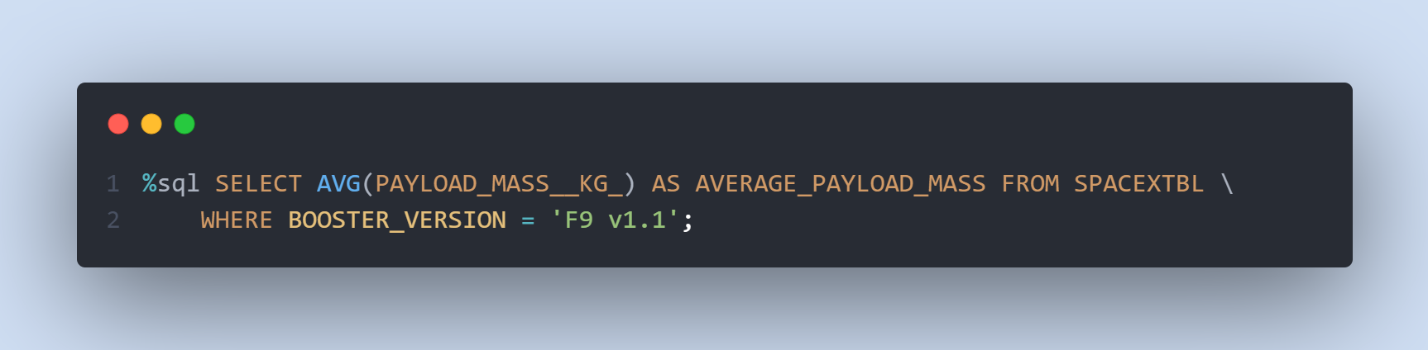
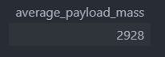
Average Payload Mass by F9 v1.1
Calculate the average payload mass carried by booster version F9 v1.1.
The AVG keyword is used to calculate the average of the PAYLOAD_MASS__KG_ column, and the WHERE keyword (and the associated condition) filters the results to only the F9 v1.1 booster version.

Slide 28
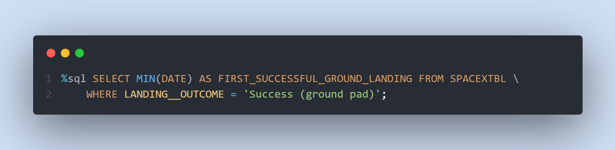
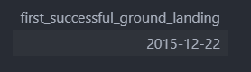
First Successful Ground Landing Date
Find the dates of the first successful landing outcome on ground pad.
The MIN keyword is used to calculate the minimum of the DATE column, i.e. the first date, and the WHERE keyword (and the associated condition) filters the results to only the successful ground pad landings.

Slide 29
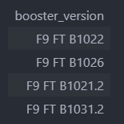
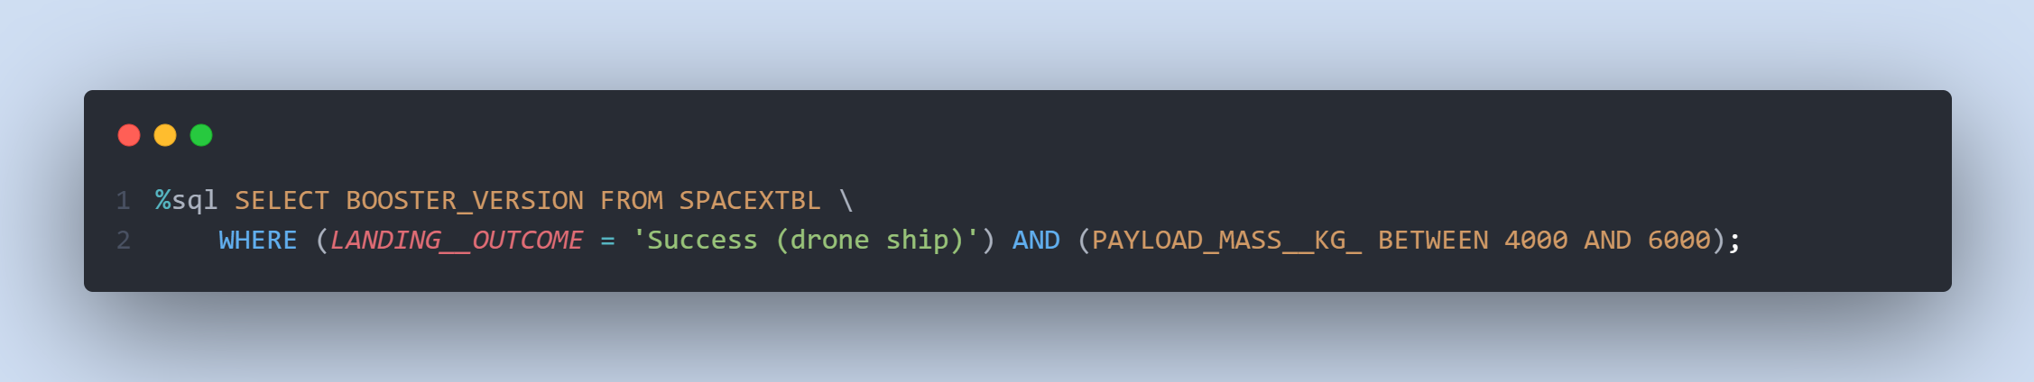
Successful Drone Ship Landing with Payload between 4000 and 6000
List the names of boosters which have successfully landed on drone ship and had payload mass greater than 4000 but less than 6000.
The WHERE keyword is used to filter the results to include only those that satisfy both conditions in the brackets (as the AND keyword is also used). The BETWEEN keyword allows for 4000 < x < 6000 values to be selected.

Slide 30
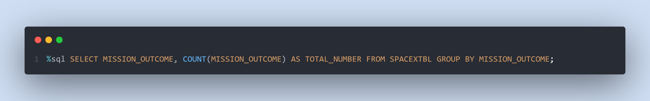
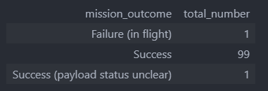
Total Number of Successful and Failure Mission Outcomes
Calculate the total number of successful and failure mission outcome.
The COUNT keyword is used to calculate the total number of mission outcomes, and the GROUPBY keyword is also used to group these results by the type of mission outcome.

Slide 31
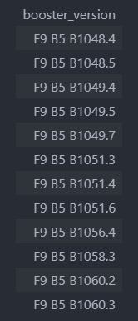
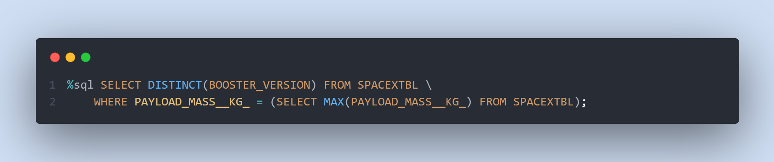
Boosters Carried Maximum Payload
List the names of the booster which have carried the maximum payload mass.
A subquery is used here. The SELECT statement within the brackets finds the maximum payload, and this value is used in the WHERE condition. The DISTINCT keyword is then used to retrieve only distinct /unique booster versions.

Slide 32
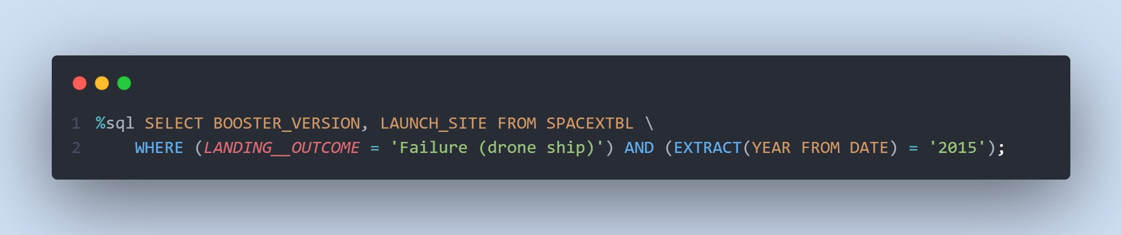
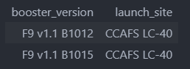
2015 Launch Records
List the failed landing_outcomes in drone ship, their booster versions, and launch site names for in year 2015.
The WHERE keyword is used to filter the results for only failed landing outcomes, AND only for the year of 2015.

Slide 33
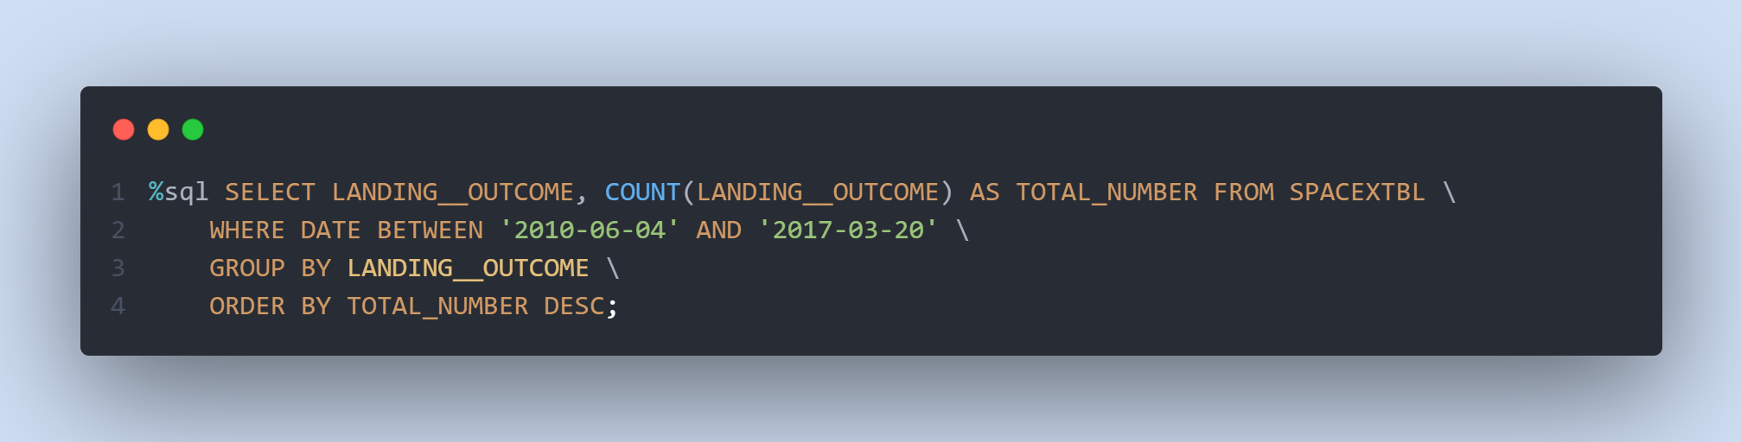
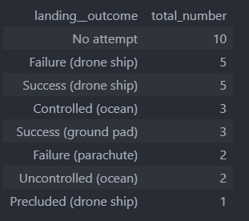
Rank Landing Outcomes Between 2010-06-04 and 2017-03-20
Rank the count of landing outcomes (such as Failure (drone ship) or Success (ground pad)) between the date 2010-06-04 and 2017-03-20, in descending order.
The WHERE keyword is used with the BETWEEN keyword to filter the results to dates only within those specified. The results are then grouped and ordered, using the keywords GROUP BY and ORDER BY, respectively, where DESC is used to specify the descending order.

Slide 34

Section 3

Slide 35
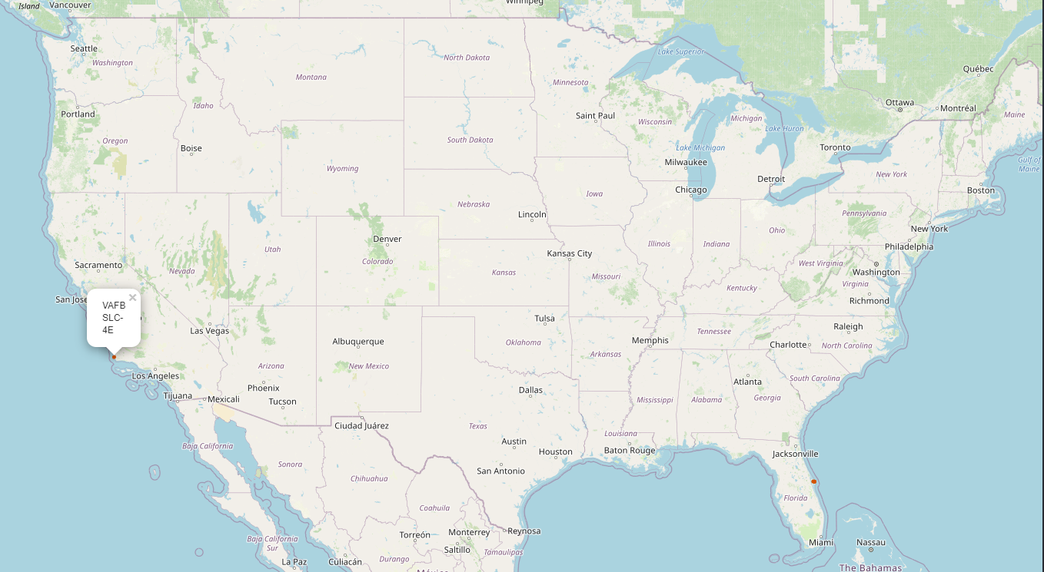



All Launch Sites On A Map
All SpaceX launch sites are on coasts of the United States of America, specifically Florida and California.

Slide 36






Success/Failed Launches For Each Site
Launches have been grouped into clusters, and annotated with green icons for successful launches, and red icons for failed launches.
CCAFS SLC-40 and CCAFS LC-40
VAFB SLC-4E
KSC LC-39A
$$=$$

Slide 37



Proximity Of Launch Sites To Other Points Of Interest
Are launch sites near railways?
YES. The coastline is only 0.87 km due East.
Are launch sites near highways?
YES. The nearest highway is only 0.59km away.
Are launch sites near railways?
YES. The nearest railway is only 1.29 km away.
Do launch sites keep a certain distance away from cities?
YES. The nearest city is 51.74 km away.
Using the CCAFS SLC-40 launch site as an example site, we can understand more about the placement of launch sites.

Slide 38

Section 4

Slide 39

launch success count for all sites
The launch site KSC LC-39 A had the most successful launches, with 41.7% of the total successful launches.

Slide 40

Pie chart for the launch site with highest launch success ratio
The launch site KSC LC-39 A also had the highest rate of successful launches, with a 76.9% success rate.

Slide 41




Launch Outcome VS. Payload scatter plot for all sites
1
1
Low payloads
2
Massive payloads
2
Plotting the launch outcome vs. payload for all sites shows a gap around 4000 kg, so it makes sense to split the data into 2 ranges:
0 – 4000 kg (low payloads)
4000 – 10000 kg (massive payloads)
From these 2 plots, it can be shown that the success for massive payloads is lower than that for low payloads.
It is also worth noting that some booster types (v1.0 and B5) have yet to be launched with massive payloads.
Note: c$lass\left\{\begin{aligned}0, Failure \\ 1, Success\end{aligned}\right.$

Slide 42

Section 5

Slide 43



Classification Accuracy
Plotting the Accuracy Score and Best Score for each classification algorithm produces the following result:
The Decision Tree model has the highest classification accuracy
The Accuracy Score is 94.44%
The Best Score is 90.36%

Slide 44
Confusion Matrix
As shown previously, best performing classification model is the Decision Tree model, with an accuracy of 94.44%.
This is explained by the confusion matrix, which shows only 1 out of 18 total results classified incorrectly (a false positive, shown in the top-right corner).
The other 17 results are correctly classified (5 did not land, 12 did land).

Slide 45
Conclusions
As the number of flights increases, the success rate at a launch site increases, with most early flights being unsuccessful. I.e. with more experience, the success rate increases.
Between 2010 and 2013, all landings were unsuccessful (as the success rate is 0).
After 2013, the success rate generally increased, despite small dips in 2018 and 2020.
After 2016, there was always a greater than 50% chance of success.
Orbit types ES-L1, GEO, HEO, and SSO, have the highest (100%) success rate.
The 100% success rate of GEO, HEO, and ES-L1 orbits can be explained by only having 1 flight into the respective orbits.
SSO's 100% success rate is more impressive, with 5 successful flights.
The orbit types PO, ISS, and LEO, have more success with heavy payloads:
VLEO (Very Low Earth Orbit) launches are associated with heavier payloads, which makes intuitive sense.
The launch site KSC LC-39 A had the most successful launches, with 41.7% of the total successful launches and the highest rate of successful launches, with a 76.9% success rate.
The success for massive payloads (over 4000kg) is lower than that for low payloads.
The best-performing classification model is the Decision Tree model, with an accuracy of 94.44%.

Slide 46



Appendix
Data Collection – space x REST api
Custom functions to retrieve the required information
Custom logic to clean the data

Slide 47


Appendix
Data Collection – Web Scraping
Custom functions for web scraping
Custom logic to fill up the launch_dict values with values from the launch tables

Slide 48


